Slide 1
Dual enrollment college application process financial aid
Miss Reed
Curtis Baptist School

Slide 2
What is dual enrollment??
Dual Enrollment is a program where high school students can take classes through a Georgia college or University which results in college AND high school credit!!
Dual Enrollment in the state of Georgia is FREE for students!
Students who live in South Carolina can still get their classes paid for as long as they take their Dual Enrollment classes at a Georgia college or university.

Slide 3
Dual enrollment facts
  Students are eligible their 11th and 12th grade year
  The state will pay for up to 30 semester hours or 45 quarter hours (Augusta University is done by semesters where Georgia Military College is done by quarters)
  Dual Enrollment courses are weighted, meaning the class will be out of a 5.0 instead of out of a typical 4.0. This gives the students GPA a boost.
  Dual Enrollment classes meet HOPE Rigor Requirements

Slide 4
Classes are offered through:
Augusta University
Georgia Military College
**If a student wants to take Dual Enrollment courses at a South Carolina college, they can, however, they will not be paid for by the state of Georgia. South Carolina does offer the courses at a discounted rate.

Slide 5
Places to take classes:
Online here at Curtis Baptist
On campus at Augusta University or Georgia Military college
  If they decide to do the class on campus, they will need to work with Miss Reed to find the best time.

Slide 6
Application process:
Meet with Miss Reed to see if they are eligible based on GPA requirement of 3.25
Apply to the college
Miss Reed will send transcript to the college
Complete funding application for dual enrollment through GAFutures
Attend orientation at the college
Register for classes with the college the first semester or quarter. After the first semester or quarter, they will get with Miss Reed to get registered for other semesters and quarters.

Slide 7
Things to consider:
Grades and assignments come from college professors and have set deadlines, very little grace given for late assignments
Miss Reed is not always aware of student performance. Student must take responsibility to make sure they are turning in their work.
Students must come to Miss Reed if they are struggling and need help
Students will be seen as college students by the college professors. Meaning they have to take the lead in communicating with the professor if they have questions or concerns
If they fail or drop a class, the state will not pay for them to retake the course. This could also cause them to be short a credit for graduation.

Slide 8
Choosing classes:
Students will meet with Miss Reed to pick the appropriate classes for graduation.
Students will discuss with Miss Reed about major options in college. This will help guide what classes they need to take to go towards that major.

Slide 9
Applying to college

Slide 10
When should I start applying?
The summer before your senior year is the best time to start the college application process. Most students do the majority of their application work in the fall of their senior year.
Starting this year, students will meet with Miss Reed annually to discuss their graduation plan. During the Fall of their senior year, they will start applying for their college choices.

Slide 11
What is a good starting point for this process?
Find out what goes into an application and begin collecting the materials you need. Create a folder for each college you are applying to. At the front of each folder, put a checklist of what you’ll need for the application and when it’s due.

Slide 12
How many colleges should I apply to?
College applications cost money. If you can narrow your selection down to three to five colleges, that is a common and manageable number. They should all be colleges you’d be happy to attend. It’s good to apply to some colleges that are a bit of a stretch for you and some that you feel will likely admit you. But most should feel like good, realistic matches.

Slide 13
What is the difference between the types of admission?
Early action is the admissions process where a student applies to a school by the specified deadline and will receive a decision after the school has completed their early action application process. If admitted to the school, the student may have until a certain date to let the school know if he or she is going to enroll at the school.
Early decision is the admissions process where a student will apply to a school by the early decision deadline and will receive a decision after the school has completed their application process for early applicants. The most significant difference between these two processes is that early decision is binding, which means that any student who applies and is admitted to a school through early decision is expected to enroll. Early decision applications typically require some type of signed form that indicates this intention to enroll upon admission. If a student is admitted through early decision, he or she is expected to withdraw all other applications and submit the matriculation fee (or fee waiver) upon receiving the offer.
Regular decision is the admissions process where students apply to a school by a deadline and will receive a decision when the school notifies all applicants. The application deadlines for regular decision will vary based on the school but typically range from November to March.
Rolling admissions is similar to regular decision except that schools will typically notify students of their admission as soon as all admissions documents have been submitted. The deadlines will vary by school.

Slide 14
Plan&Pay4College
The Georgia Student Finance Commission believes every Georgia high school graduate should have the opportunity to attend college. With this initiative, GSFC is developing an academic and financial aid profile for high school students to share important information regarding planning for college and aid available to assist with paying for college.
By 2025 it is projected that over 60% of the jobs in Georgia will require some form of college education. Whether that's a certificate, associate degree, bachelor's degree – GSFC is here to help you prepare for college!
High School Students – create or sign in to your GAfutures account to view the 9th through 12th grade Plan&Pay4CollegeGA guide pages.

Slide 15
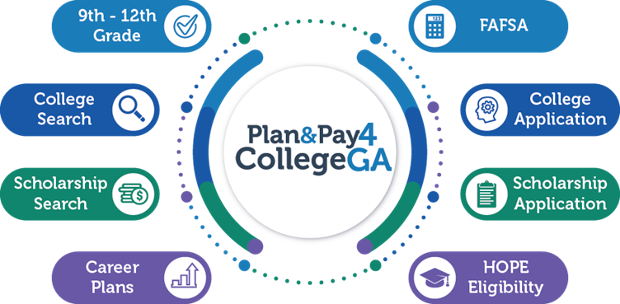

Slide 16
ACT and SAT Testing at Curtis
ACT School Day Test Date- November 1, 2024
SAT School Day Test Date- October 4, 2024

Slide 17
ACT Testing
2024-2025 National Test Dates Schedule
Test Date | Regular Registration Deadline Late Fee Applies After This Date | Late Registration Deadline | Photo Upload and Standby Deadline
September 14, 2024 | August 9 | August 25 | September 6
October 26, 2024 | September 20 | October 7 | October 18
December 14, 2024 | November 8 | November 22 | December 6
February 8, 2025 | January 3 | January 20 | January 31
April 5, 2025 | February 28 | March 16 | March 28
June 14, 2025 | May 9 | May 26 | June 6
July 12, 2025* | June 6 | June 20 | July 4
Link to register https://www.act.org/content/act/en/products-and-services/the-act/registration.html

Slide 18
SAT Testing
August 2024–June 2025 Test Dates
These test dates and deadlines apply to all students—U.S. and international—taking the SAT:
SAT Test Date* Registration Deadline Deadline for Changes, Regular Cancellation, and Late Registration**
Aug 24, 2024 Aug 9, 2024 Aug 13, 2024
Oct 5, 2024 Sept 20, 2024 Sept 24, 2024
Nov 2, 2024 Oct 18, 2024 Oct 22, 2024
Dec 7, 2024 Nov 22, 2024 Nov 26, 2024
Mar 8, 2025 Feb 21, 2025 Feb 25, 2025
May 3, 2025 Apr 18, 2025 April 22, 2025
June 7, 2025 May 22, 2025 May 27, 2025
Link to register https://satsuite.collegeboard.org/sat/registration

Slide 19
ACT/SAT Superscoring
Many colleges SuperScore during their application process
Schools who SuperScore the SAT combine the top reading and top math score
School who SuperScore the ACT combine the top subject area scores and divide by four, giving you a new Composite score.

Slide 20
Financial Aid

Slide 21
Financial aid
  I will send out scholarship opportunities as I see them
  College Board has the BigFuture Scholarships. No essay, no minimum GPA or test score, or citizenship requirements. Just follow the steps for chances to win. The more steps you complete and the earlier you start, the more chances you have to win! Here is the link to access this scholarship opportunity: https://bigfuture.collegeboard.org/pay-for-college/bigfuture-scholarships?navId=gh-cbos
  GAFutures has a section where you can search categories to find potential scholarship opportunities. Here is the link https://www.gafutures.org/scholarship-search
  FAFSA The Free Application for Federal Student Aid (FAFSA) is the main application used to apply for federal or state-supported financial aid to pay for a college education. Completing and submitting the FAFSA is free, easy and provides you access to the largest source of financial aid available.
    Financial aid covers expenses like tuition and fees, room and board, books and supplies, transportation and other college-related expenses. The FAFSA can be used to determine eligibility for:
    Federal Student Aid – Pell Grants and student loans.
    State Financial Aid – HOPE Scholarship and Grant programs.
    Institutional Financial Aid – Institutional Scholarships offered by a college.
    Private Financial Aid – Private Scholarships provided by businesses or other organizations.
  Link to the FAFSA pamphlet https://www.gafutures.org/media/iyefodej/fafsa-combined-checklists-fy2024_digital.pdf

Slide 22
HOPE Scholarship
  HOPE Scholarship is only for Georgia residents. I will submit the students final transcript after they graduate. There is nothing you have to upload. The requirements for HOPE Scholarship are:
    HOPE Scholarship Academic Eligibility Requirements as an entering freshman at an eligible college or university in Georgia (after high school graduation or home study completion)
    Meet the following criteria:
    Graduate with a minimum 3.0 calculated HOPE GPA.
    Earn a minimum of four full rigor credits from the https://www.gafutures.org/media/scdfe1zp/academic-rigor-course-october-2023-02122024.pdf
    Here is a digital copy of the HOPE program pamphlet that helps explain the scholarship https://www.gafutures.org/media/cdyda10c/fy24_hope-program-summary_digital.pdf
  Understanding the HOPE GPA:
    https://www.gafutures.org/hope-state-aid-programs/hope-zell-miller-scholarships/hope-scholarship/understanding-the-high-school-hope-gpa/

Slide 23
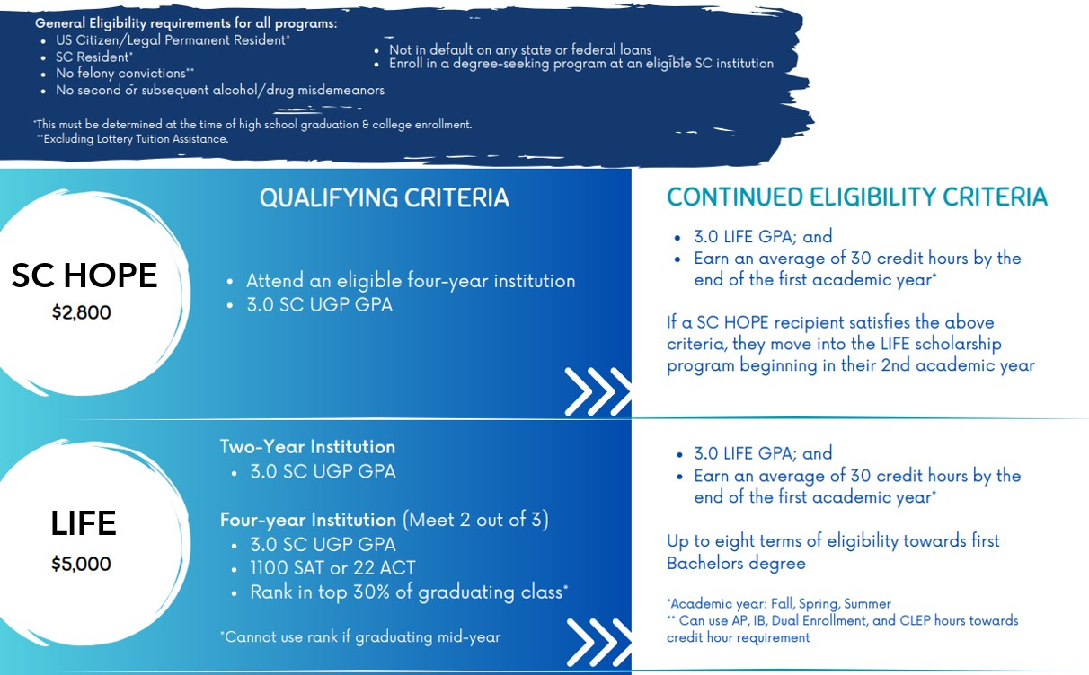
South Carolina scholarships
  This link gives more detailed information about each scholarship
  https://www.che.sc.gov/students-families-and-military/scholarships-and-grants-sc-residents

Slide 24
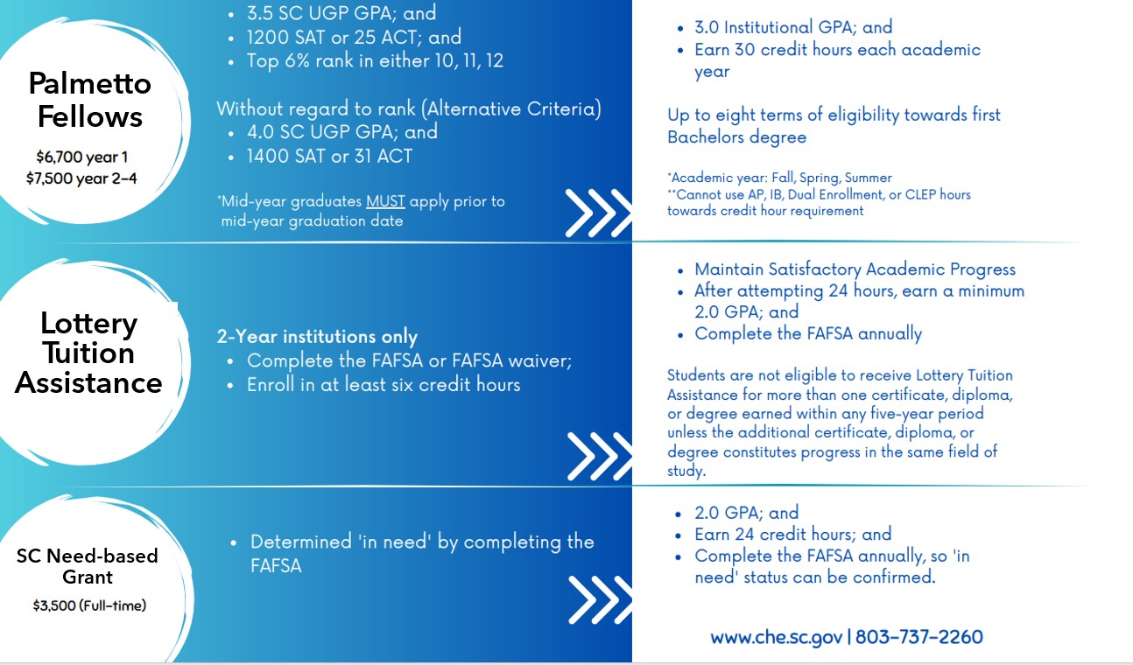
South Carolina scholarships

Slide 25
Helpful Resources
  Here are a few other helpful pamphlets that discuss Financial Aid and a checklist for each year 9th-12th
    https://www.gafutures.org/media/1ejdateg/fy24_paying-for-college_digital.pdf
    https://www.gafutures.org/media/jeejxxcu/9th-10th-grade-checklist-fy24_digital.pdf
    https://www.gafutures.org/media/s5rfkiy4/11th-12th-grade-checklist-fy24_digital.pdf
  This pamphlet is a College and Career Guide! It provides information, tools and resources to help make getting ready for college and future careers in Georgia easier. Here is the link: file:///C:/Users/jreed/Downloads/GAfutures%20Guide%20FY24%20DIGITAL.pdf

Slide 26

Email miss Reed jreed@curtisbaptist.org

